Slide 1
Research Training Project
DATABASE DEVELOPMENT FOR GNSS MEASUREMENT
Student name: Hoang Tra My
Student number: 151395127
Supervisor: Antoine Grenier

Slide 2
Table of contents
01
02
03
04
Introduction about the project
What I did in the project
Final results
What I learned from the project
04
Conclusion

Slide 3
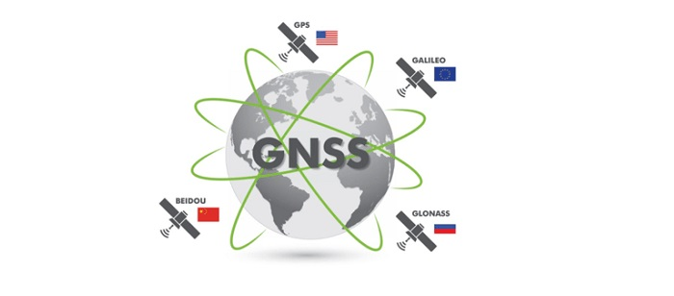
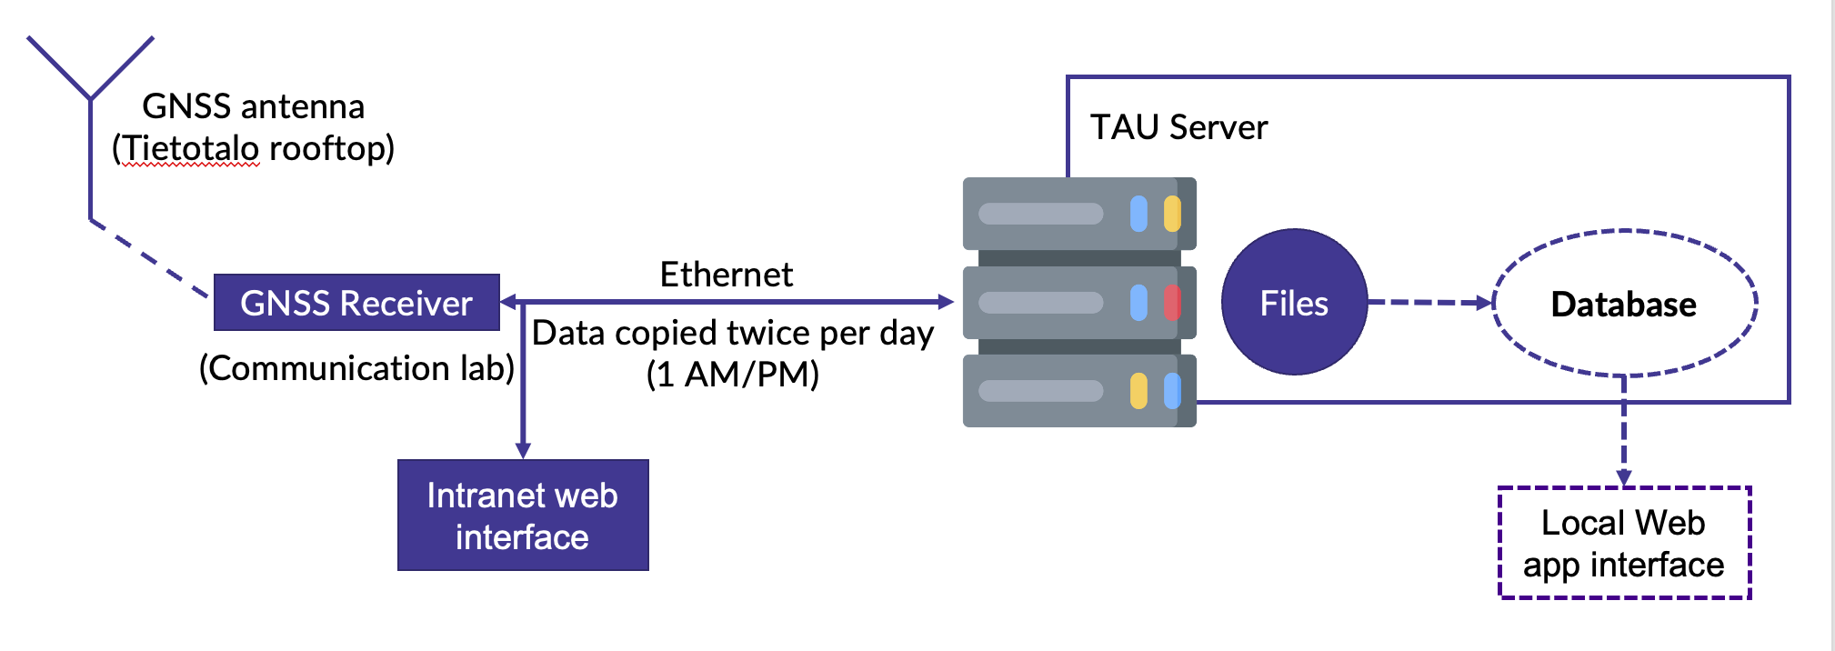
01. Introduction
- GNSS stands for Global Navigation Satellite System, also called “satellite positioning”
- High-grade GNSS receiver installed in the communication lab, connected to Intranet
- Intrant-Permanent measurement logging, archived in a remove drive on Intranet
Objectives
Create a database from the file created by the receiver
Create a routine to regularly process new data
Create a local web interface to interact with the database for researching purpose in the future (my role)

Slide 4
02. What I did
Phase 1: Learn about the Data Visualization technology: Bokeh, Plotly, Go, Dash
Phase 2: Create basic interface from the sketch of supervisor
Phase 3: Add more details for the interface
Phase 4: Connect with the database to create interactive webpage.

Slide 5
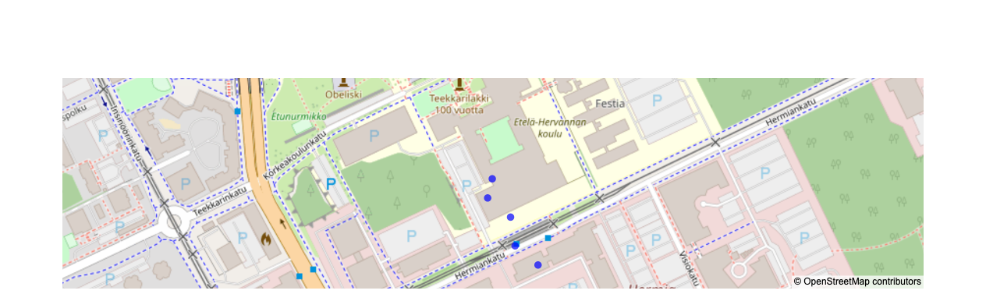
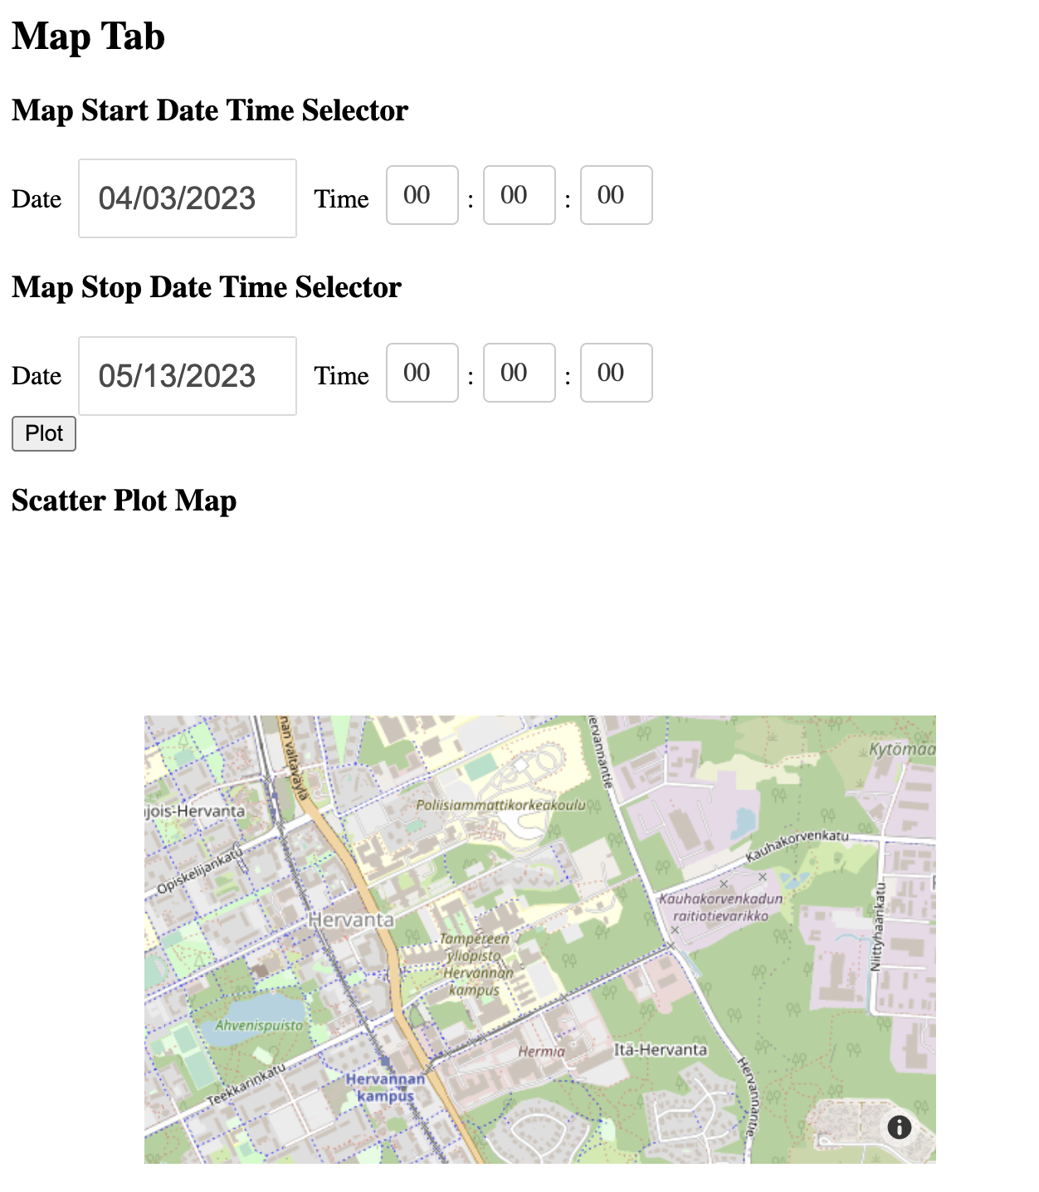
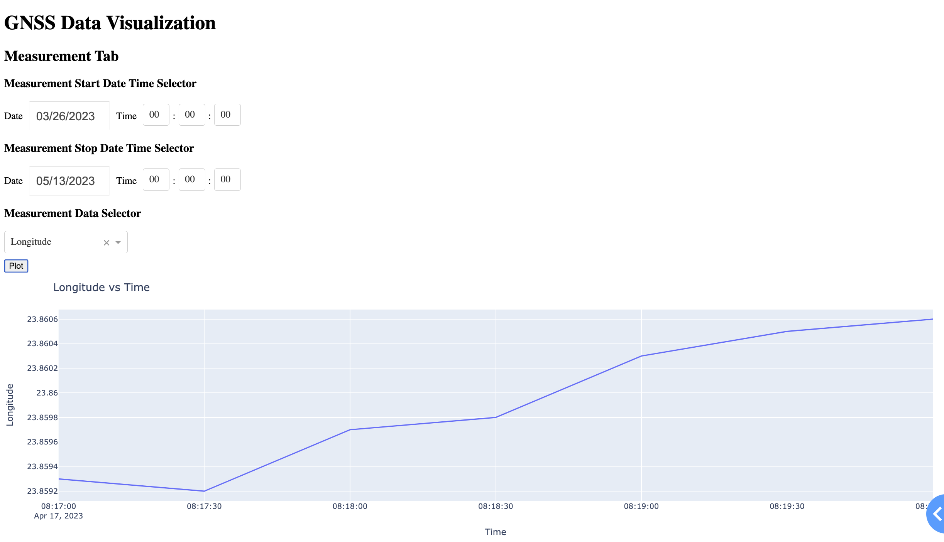
03. Final results
Coding language: Python
Web server: Dash
Dataframes, SQL interaction: Pandas
Graph and Map: Plotly or Bokeh

Slide 6
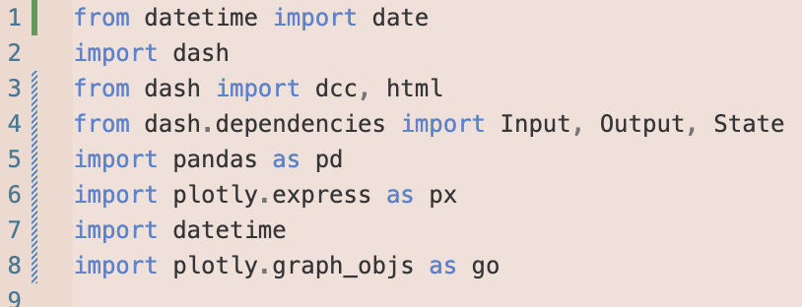
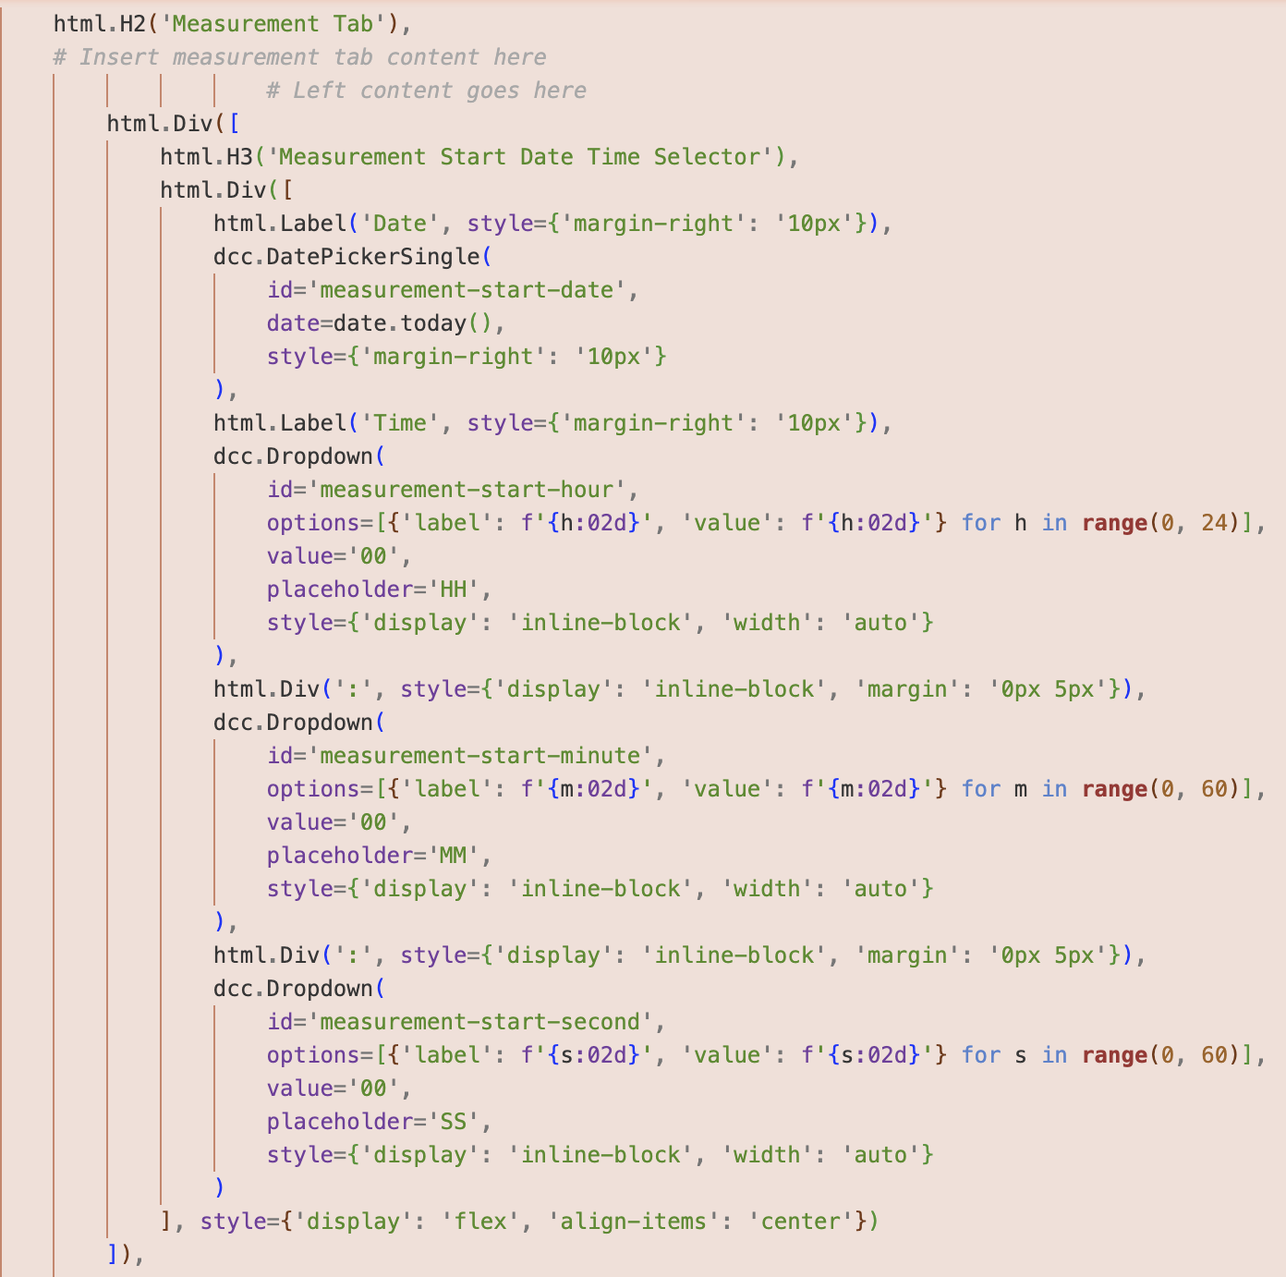
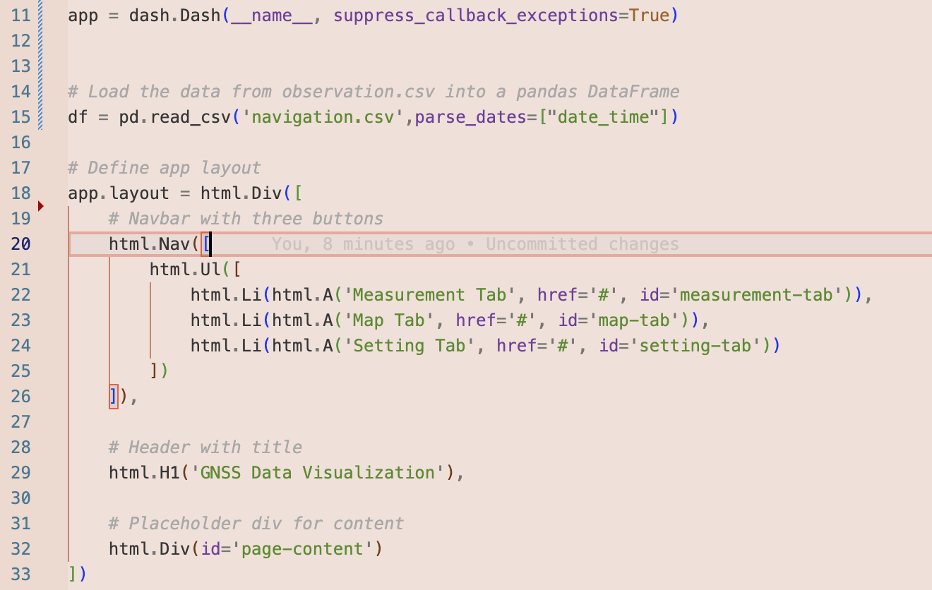
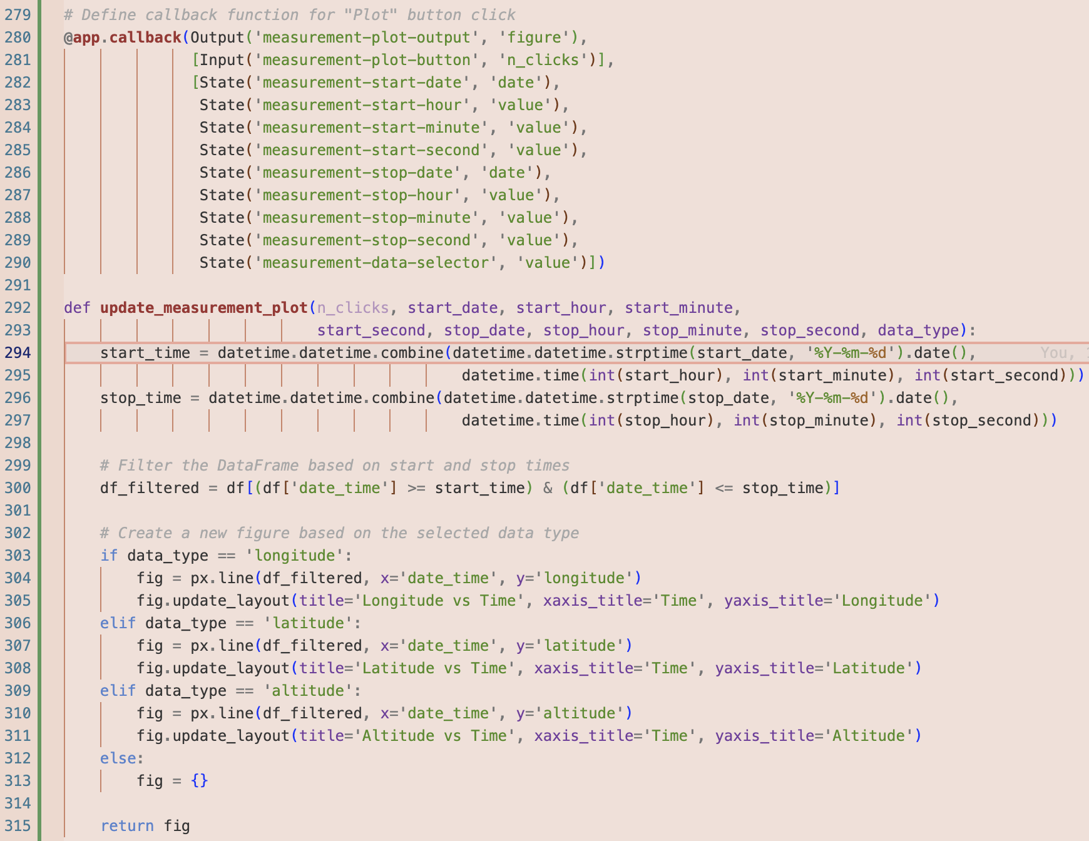
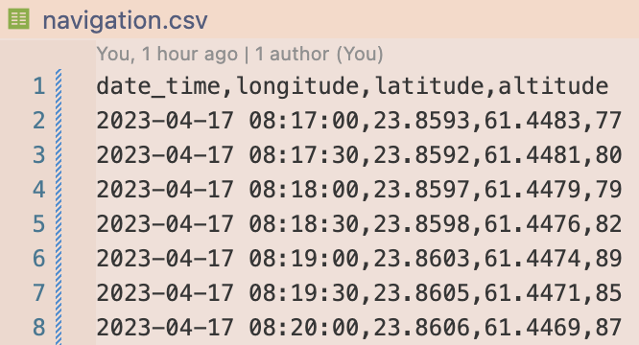
Some code snippets and logic of the code
1. include the libraries
2. Create dash app layout
read database (csv file)
=> panda dataframes
3. Create the data and time selector to filter the data
4. Create a callback function and update the plot based on user’s selection
Here are the sample data to test the interaction of the web page

Slide 7
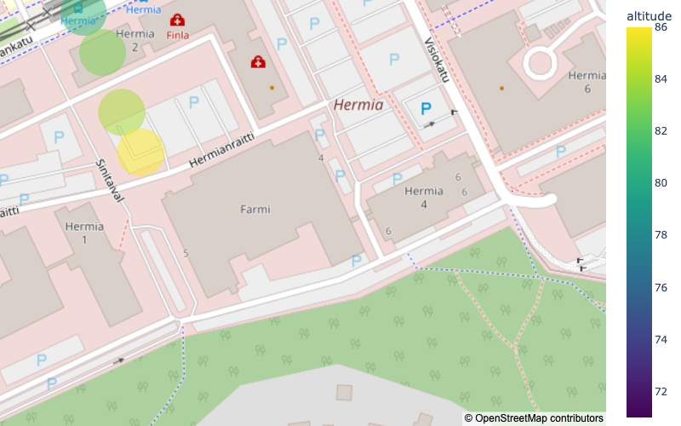
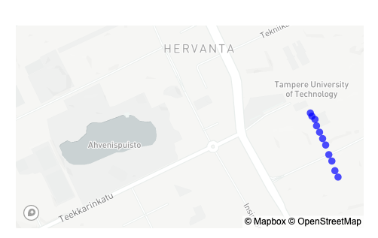
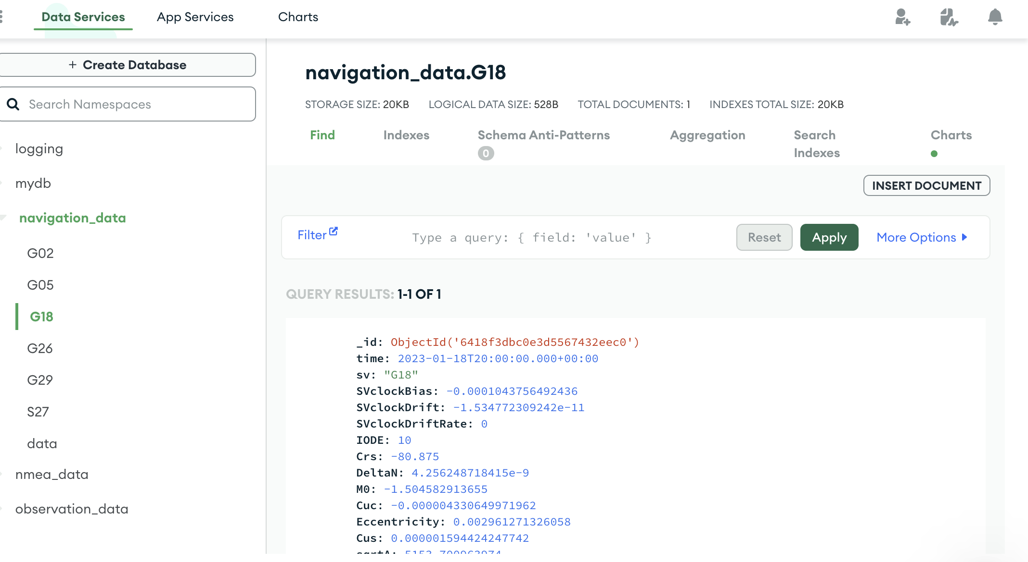
04. What I learned
Learned to use Python in a real project
Applied programming skills from completing Programming 1 Python last year
Learned how to interact with CSV files
Used Pandas dataframes to manipulate and analyze data
Used Python for data visualization for the first time
Completed a Data Visualization course on Coursera using Bokeh and obtained a certificate
Gained experience creating compelling visualizations
Gained a basic understanding of GNSS and the role of satellites in this technology
Learned how to use MongoDB, a popular NoSQL database program, to store and manage large amounts of data
Created multiple types of maps using Bokeh, including heatmaps, choropleth maps, and scatter maps

Slide 8
Thank you for listening!
05. Conclusion
In summary, this project allowed me to develop and apply a range of data analysis and visualization skills, including working with CSV files, manipulating data using Pandas data frames, and creating compelling visualizations and multiple types of maps using Bokeh. The project involved four phases and aimed to create a database, process new data, and create a local web interface for future research purposes. Overall, this was a valuable learning experience that helped me to deepen my understanding of data analysis and visualization.
Any questions or comments:
Email: my.hoang@tuni.fi

